Slide 1
Olist store analysis
Brazillian e commerce
Modules: Excel, Powerbi, tableau, SQL

Slide 2
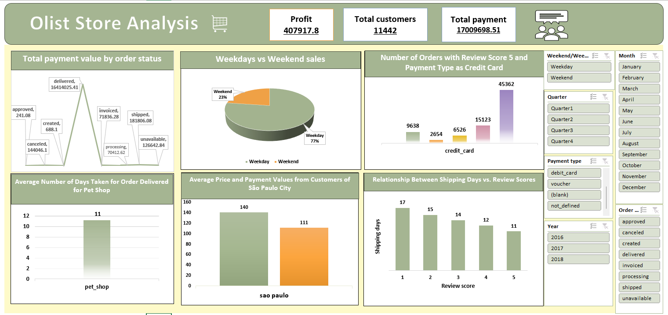
Excel dashboard:

Slide 3
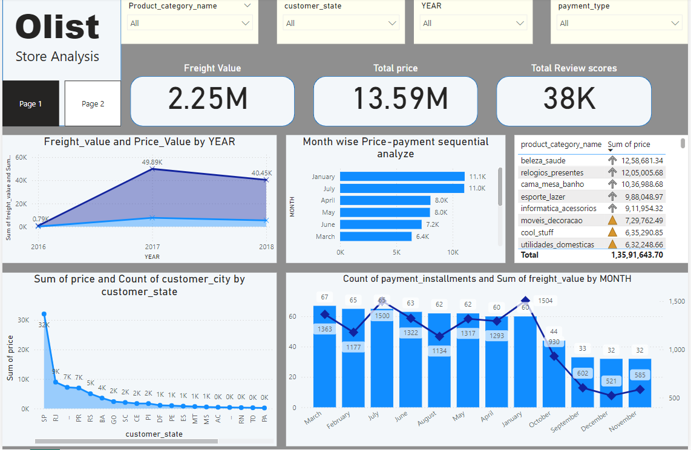
Power bi dashboard:

Slide 4
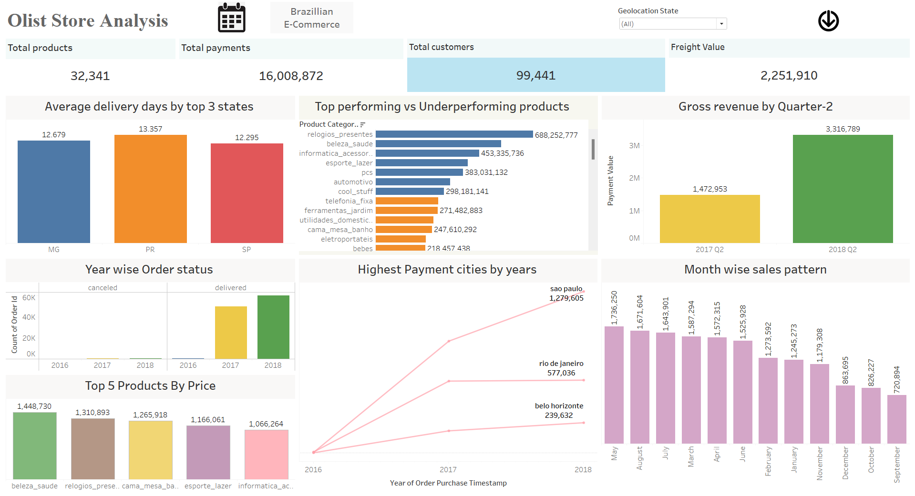
Tableau dashboard:

Slide 5
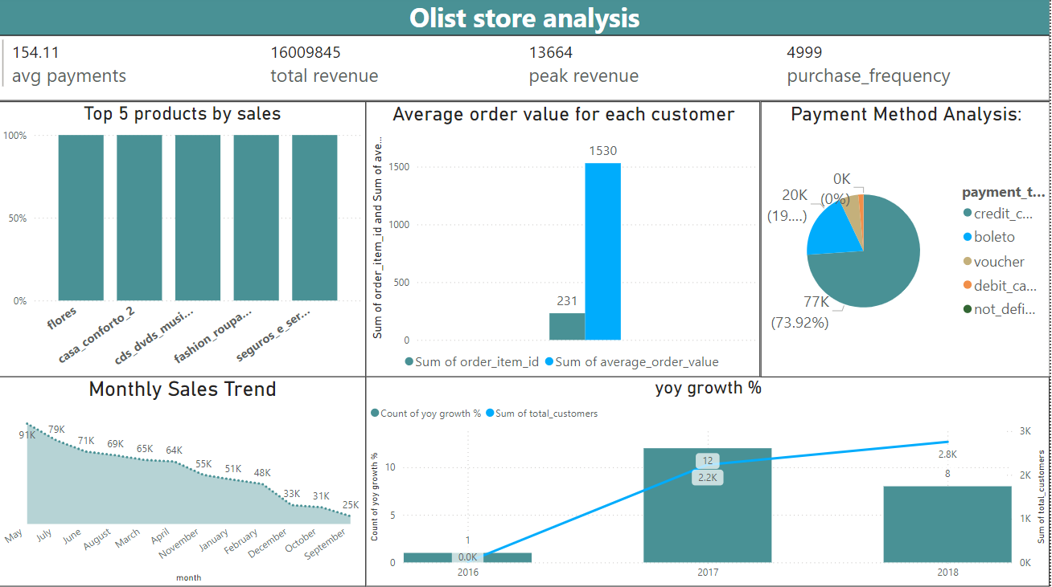
SQL dashboard:

